Slide 1

Principles of Microeconomics Session 5: On the other side of Tuas (Production)
Associate Professor Jonathan Tan
j.tan@ntu.edu.sg

Slide 2

Production Choice
There are three building blocks of the analysis of producer choice
Production Technology
Describe how inputs can be transformed into output (Q)
Cost Constraints
Firms must consider prices of inputs → labor (L), capital (K), etc.
Firms cannot influence input prices
Interaction between production technology and cost constraints → determine the amount and type of inputs to be used?
What combination of inputs will producers use to minimize production costs
Notes:
8

Slide 3

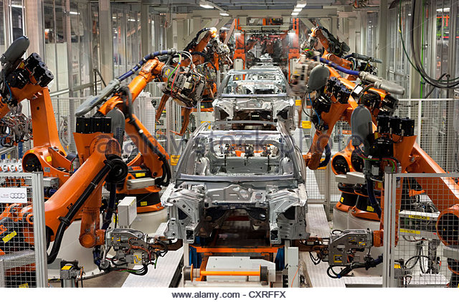

Production Technology
How might a producer compare different combinations of inputs available for use?
Firms can choose between combinations, yielding respective levels of output
For simplicity, we will consider only labor (L) and capital (K)
Notes:
10

Slide 4

Production Function = Technology
INPUTS
(K,L)
F(K,L)
OUTPUTS
Q = F(K,L)
Production
Function

Slide 5
Production Technology – Basic Assumptions
The production function is true for a given technology
If technology increases, more output can be produced for a given level of inputs
Short Run
Period of time in which quantities of one or more production factors (inputs) cannot be changed (e.g. capital)
These inputs are called fixed inputs
Therefore production choices involve variable inputs (e.g. labor)
Long-run
Amount of time needed to make all production inputs variable.
Short run and long run are not time specific

Slide 6
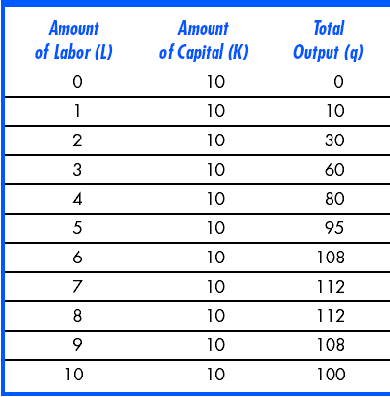

One Variable Input: An Example
When labor is zero, output is zero as well
With additional workers, output (q) increases up to 112 units
Beyond this point, output declines
Increasing labor can make better use of existing capital initially
After a point, more labor is not useful and can be counterproductive
Notes:
17

Slide 7
Productivity
Average Product of Labor - Output per unit of a particular input
Measures the productivity of a firm’s labor in terms of how much, on average, each worker can produce
Marginal Product of Labor – additional output produced when labor increases by one unit
Change in output divided by the change in labor

Slide 8
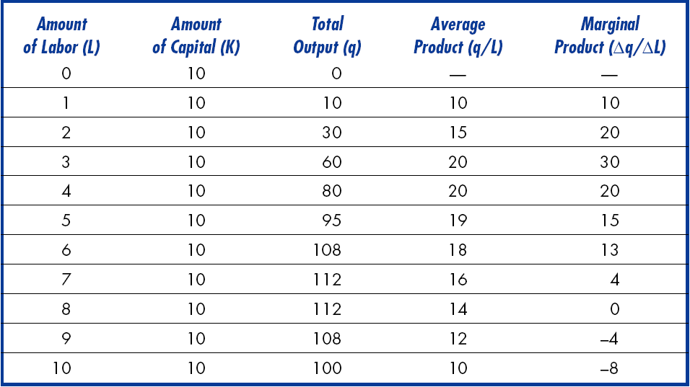
Productivity Schedule

Slide 9
Optimizing Manpower
Output
per
Month
Output varies as labor changes
Output is maximized at 112 units
As labor increases, the additional output produced decreases
= Law of Diminishing Marginal Returns (LDMR)
At some point (D) “too many cooks spoil the broth”
D
112
C
Total Product (Output)
60
At point D (L=8), output is maximized.
B
30
A
0
1
2
3
4
5
6
7
8
9
10
Labor per Month

Slide 10
Innovation
LDMR assumes constant technology
Changes in technology will cause shifts in the total product curve
More output can be produced with same inputs
Labor productivity can increase if there are improvements in technology, even though any given production process exhibits diminishing returns to labor
Output
C
100
O₃
B
As move from A to B to C labor productivity is increasing
A
O₂
50
O₁
Labor per
time period
0
1
2
3
4
5
6
7
8
9
10

Slide 11
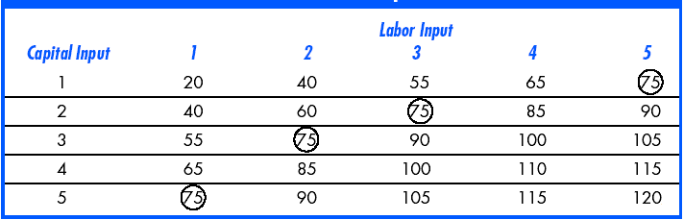
Production: Two Variable Inputs
Firm can produce q by combining different amounts of labor and capital
In the long-run, capital and labor are both variable.
Look at the output achievable with different combinations of K and L

Slide 12
Isoquants: An Example
Capital
per year
5
E
This information can be represented graphically using isoquants
Curves showing all possible combinations of inputs that yield the same output
Curves are smooth to allow for use of fractional inputs
Curve 1 shows all possible combinations of labor and capital that will produce 55 units of output
E.g. 55 units of output can be produced with
3K & 1L (pt. A)
OR
1K & 3L (pt. D)
4
3
A
B
C
2
q₃ = 90
D
q₂ = 75
1
q₁ = 55
1
2
3
4
5
Labor per year

Slide 13
Diminishing Returns to Capital
Capital
per year
5
Holding labor constant at 3
Increasing capital from 0 to 1 to 2 to 3
Output increases by 0, 55, 20, 15, i.e. at a decreasing rate
Diminishing returns from capital in both short-run and long-run
Increasing labor holding capital constant (A, B, C)
OR
Increasing capital holding labor constant (E, D, C
4
3
A
B
C
2
D
q₃ = 90
1
E
q₂ = 75
q₁ = 55
1
2
3
4
5
Labor per year
Notes:
56

Slide 14
Production: Two Variable Inputs
Substituting Among Inputs
Firms must decide what combination of inputs to use to produce a certain quantity of output
There is a trade-off between inputs allowing them to use more of one input and less of another for the same level of output
Slope of the isoquant shows how one input can be substituted for the other while keeping the level of output the same.
Marginal rate of technical substitution (MRTS)
Amount by which the quantity of one input can be reduced when one extra unit of another input is used, so that output remains constant.
Notes:
57

Slide 15
Marginal Rate of Technical Substitution (MRTS)
Capital
per year
5
Slope measures MRTS
MRTS decreases as move down the isoquant (diminishing MRTS)
-2
4
As we increase labor to replace capital
Labor becomes relatively less productive
Capital becomes relatively more productive
Need less capital to keep output constant
The slope of the isoquant becomes flatter
3
1
-1
2
1
-2/3
Q₃ =90
1
1
-1/3
Q₂ =75
1
Q₁ =55
1
2
3
4
5
Labor per month

Slide 16
Isoquants: Perfect substitutes
Two extreme cases show the possible range of input substitution in production
Perfect substitutes
MRTS is constant at all points on isoquant
Same output can be produced with a lot of capital or a lot of labor or a balanced mix
Capital
per
month
A
Same output can be reached with mostly capital or mostly labor (A or C) or with equal amount of both (B)
B
C
Q₁
Q₂
Q₃
Labor
per month

Slide 17
Isoquants: Perfect Complements
Capital
per
month
Perfect Complements
Fixed proportions production function
There is no substitution available between inputs
The output can be made with only a specific proportion of capital and labor
Cannot increase output unless increase both capital and labor in that specific proportion
Same output can only be produced with one set of inputs.
Q₃
C
Q₂
B
K₁
Q₁
A
Labor
per month
L₁
Notes:
65

Slide 18
Returns to Scale
Returns to Scale: Rate at which output increases as inputs are increased proportionately
In addition to discussing the tradeoff between inputs to keep production the same
How does a firm decide, in the long run, the best way to increase output
Can change the scale of production by increasing all inputs in proportion
If double inputs, output will most likely increase but by how much?
Notes:
74

Slide 19
Increasing Returns to Scale
Capital
(machine
hours)
A
Output more than doubles when all inputs are doubled
4
The isoquants move closer together
q=30
2
q=20
q=10
5
10
Labor (hours)
Notes:
75

Slide 20
Returns to Scale
Capital
(machine
hours)
A
Output doubles when all inputs are doubled
6
30
4
Constant Returns: Isoquants are equally spaced
20
2
10
5
10
15
Labor (hours)
Notes:
75

Slide 21
Returns to Scale
Capital
(machine
hours)
A
Output less than doubles when all inputs are doubled
4
Decreasing Returns:
Isoquants get further
apart
15
2
10
5
10
Labor (hours)
Notes:
75

Slide 22
Different types of cost
22
Accounting Cost
Actual expenses plus depreciation charges for capital equipment
Opportunity cost
Cost associated with opportunities that are foregone when a firm’s resources are not put to their highest-value use
E.g. empty office rooms, parked up lorries, …?
Economic Cost
Cost to a firm of utilizing economic resources in production, including opportunity cost
Sunk Cost
Expenditure that has been made and cannot be recovered
Should NOT influence a firm’s future economic decisions

Slide 23
Breaking it down
23
Total cost (TC):
Fixed Cost
Does not vary with the level of output
Variable Cost
Cost that varies as output varies
Average Total Cost (ATC):
Cost per unit of output
Also equals average fixed cost (AFC) plus average variable cost (AVC).
Marginal Cost (MC):
The cost of expanding output by one unit.
Fixed cost have no impact on marginal cost, so it can be written as:
MC is the slope of the TC function

Slide 24
Cost Curves for a Firm
24
Cost
($ per
year)
TC
400
VC
Variable cost
increases with
production and
the rate varies with
increasing &
decreasing returns.
300
200
175
100
50
FC
0
1
2
3
4
5
6
7
8
9
10
11
12
13
Output
MC
ATC
AVC
AFC
0
1
2
3
4
5
6
7
8
9
10
11
12
13
Notes:
When MC is below AVC, AVC is falling
When MC is above AVC, AVC is rising
When MC is below ATC, ATC is falling
When MC is above ATC, ATC is rising
Therefore, MC crosses AVC and ATC at the minimums

Slide 25
Cost in the Long Run
25
The Isocost Line
A line showing all combinations of L & K that can be purchased for the same cost
Total cost of production is sum of firm’s labor cost, wL and its capital cost rK
C = wL + rK
For each different level of cost, the equation shows another isocost line
Notes:
44

Slide 26
Cost in the Long Run
26
Rewriting C as an equation for a straight line:
Thus; K= C/r – (w/r) L
Slope of the isocost:
-w/r → is the ratio of the wage rate to rental cost of capital.
This shows the rate at which capital can be substituted for labor with no change in cost.
Notes:
45

Slide 27
Producing a Given Output at Minimum Cost
27
Capital
per
year
Q₁ is an isoquant for output Q_{1.}
There are three isocost lines, of which 2 are possible choices in which to produce Q1
K₂
Isocost C₂ shows quantity
Q₁ can be produced with
combination K₂L₂ or K₃L₃.
However, both of these
are higher cost combinations
than K₁L₁.
A
K₁
Q₁
K₃
C₀
C₁
C₂
L₂
L₁
L₃
Labor per year
Notes:
52

Slide 28
Input Substitution When an Input Price Change
If the price of labor changes, then the slope of the isocost line change, w/r
It now takes a new quantity of labor and capital to produce the output
If price of labor increases relative to price of capital, and capital is substituted for labor

Slide 29
Input Substitution When an Input Price Change
Capital
per
year
If the price of labor
rises, the isocost curve
becomes steeper due to
the change in the slope -(w/r).
The isocost line pivots about the isoquant because we are minimizing cost given required output
This differs from consumer theory where we are maximizing utility s.t. budget constraint
The new combination of K and L is used to produce Q₁.
Combination B is used in place of combination A.
B
K₂
A
K₁
Q₁
C₂
C₁
L₂
L₁
Labor per year
Notes:
55

Slide 30
Cost in the Long Run
How does the isocost line relate to the firm’s production process?
Recall the bliss point from consumer theory?
Notes:
56

Slide 31
Cost in the Long Run
Recall the equal marginal principle from consumer theory?
The minimum cost combination:
Minimum cost for a given output will occur when each dollar of input added to the production process will add an equivalent amount of output.
Notes:
57

Slide 32
Cost in the Long Run
Cost minimization with Varying Output Levels
For each level of output, there is an isocost curve showing minimum cost for that output level
A firm’s expansion path shows the minimum cost combinations of labor and capital at each level of output.
Slope equals ΔK/ΔL
Notes:
65

Slide 33
A Firm’s Expansion Path
Capital
per
year
The expansion path illustrates
the least-cost combinations of
labor and capital that can be
used to produce each level of
output in the long-run.
150
$3000
Expansion Path
100
$2000
C
75
NOT ALWAYS linear
$1000
B
50
A
300 Units
25
200 Units
100 Units
100
150
200
300
Labor per year
50
Notes:
72

Slide 34
Expansion Path & Long-run Costs
Firms expansion path has same information as long-run total cost curve
To move from expansion path to LR cost curve
Find tangency with isoquant and isocost
Determine min cost of producing the output level selected
Graph output-cost combination
Recall plotting out the demand curve from consumer theory?

Slide 35
A Firm’s Long-Run Total Cost Curve
Cost/ Year
Long Run Total Cost
F
3000
E
2000
NOT ALWAYS linear
Depending on the shape of the output expansion path
D
1000
100
200
300
Output, Units/yr
Notes:
72

Slide 36
Long-Run Versus Short-Run Cost Curves
In the short run some costs are fixed
In the long run firm can change anything including plant size
Can produce at a lower average cost in long run than in short run
Capital and labor are both flexible
We can show this by holding capital fixed in the short run and flexible in long run
Notes:
73

